Slide 1
International Conference creating Global Connections
David Manchester
NOTE: This analysis was conducted as a class project for a client of the professor. As a result, all identifiable information has been removed.

Slide 2
Project Summary
An organization hosted an international conference to help connect people working on similar social issues in disparate parts of the world. One of their objectives was that such a convening would generate new connections which would not have been formed without the conference.

Slide 3
Project Summary
The following are the results of analysis seeking to explore the relationships that existed before and during the conference. The analysis consists of social network analysis as well as statistical modeling.

Slide 4
Estimating Conference Interaction
Analysis Goals
  Does the conference generate connections that would not likely have occurred through networking from afar?
  Can we understand what brings people together?
    Do girls spend time with people they know?
    Do girls spend time with people similar to them?
Pre and post surveys were administered.
  Before the conference: “Which participants do you currently know (check all that apply)”
  After the conference: “Please check the names of the 3 people with whom you spent the most time while you were at [the conference]”

Slide 5
Degrees In a Network
Friends are often referred to has being first degree relationship. They are directly connected.
Friends of friends are second degree connections
And the pattern can continue
By the 5th degree more than 2.25 Trillian possible pathways were checked between all the participants
You
1st
2nd
3rd
4th
5th

Slide 6
Impact of Prior Friendships
Prior friends and friends of friends account for almost 40% of responses.
Most of the participants spent time with people outside their original social network who would not likely have met otherwise.
 | Percent | Cumulative
Friends | 19% | 19.23%
2nd Degree | 19% | 38.46%
3rd Degree | 15% | 53.85%
4th Degree | 8% | 61.54%
5th Degree | 2% | 63.85%
More than 5th | 36% | 100.00%

Slide 7

Prior Connections
Individuals who arrived at the conference with more connections were less likely to be chosen by people they did not know before the conference.
Image: Dynamic Counseling Center

Slide 8
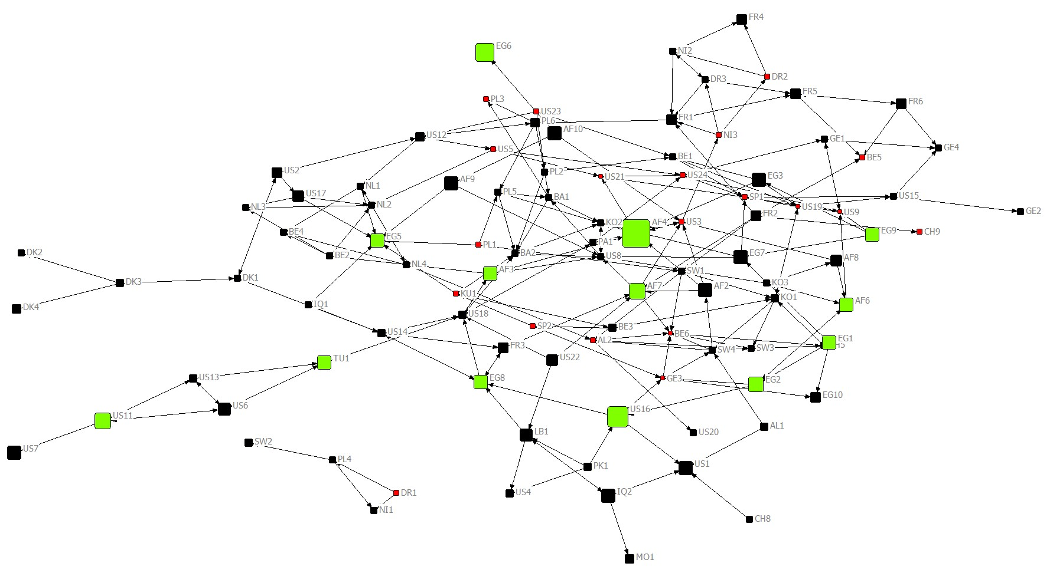
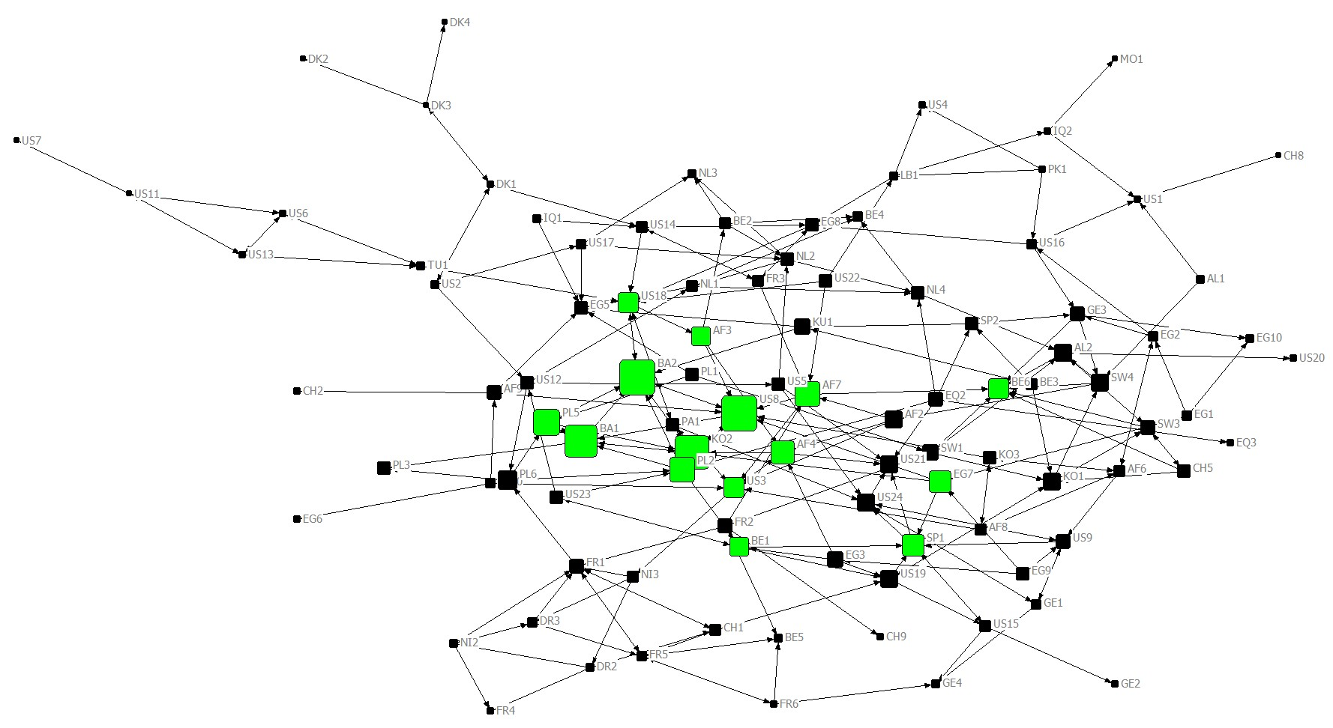
Impact of Previous Friendships
Most Connected at conference
Size - Influence
The most central individuals are highlighted in green

Slide 9
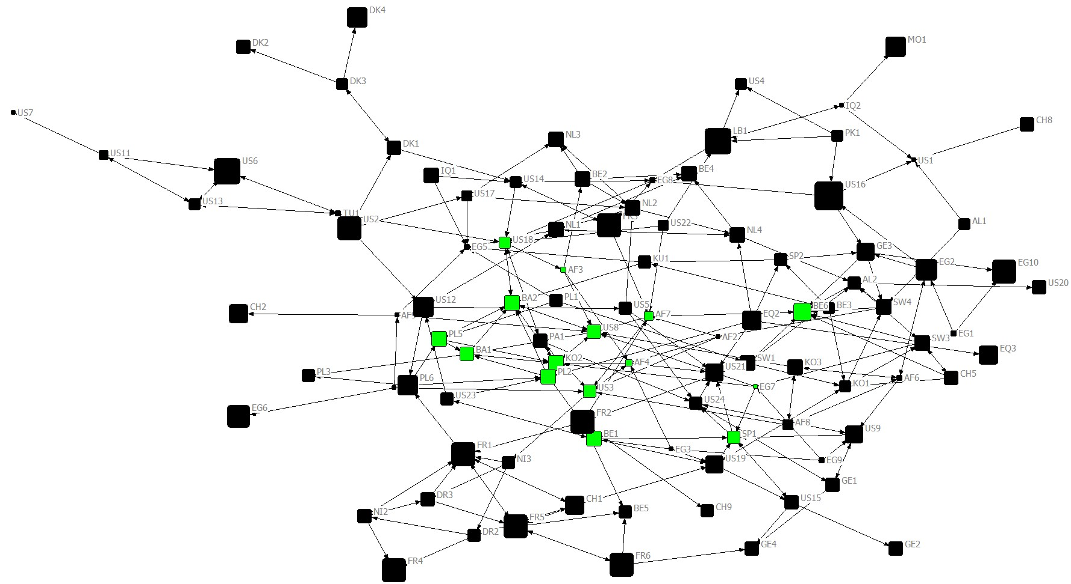
Impact of Previous Friendships
Most Connected at conference
Size – Previous Connections
While central at the conference, they entered knowing fewer individuals

Slide 10
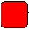
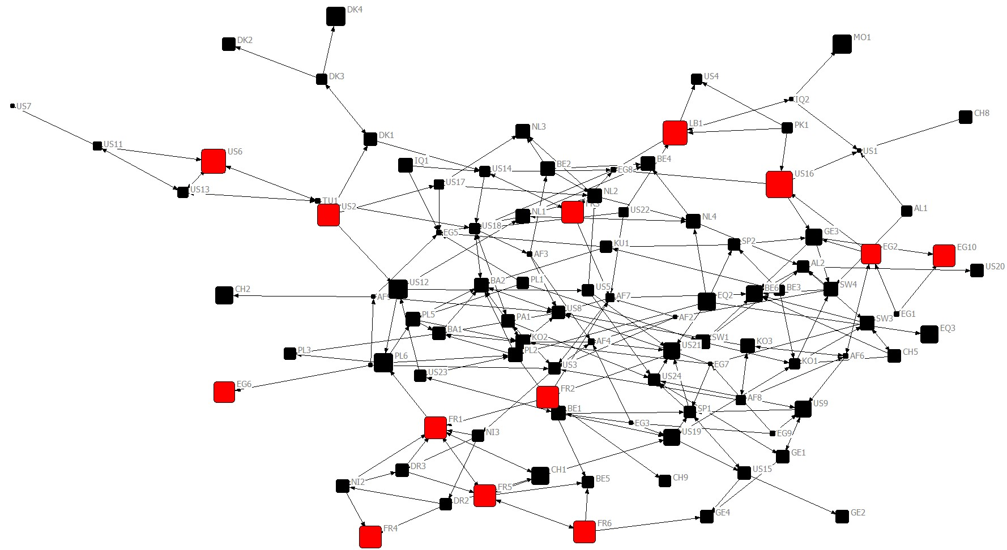
Impact of Previous Friendships
Most Friends Before conference
Size – Previous Connections
Those with the most friends before the conference tended to be on the periphery of the conference social network

Slide 11
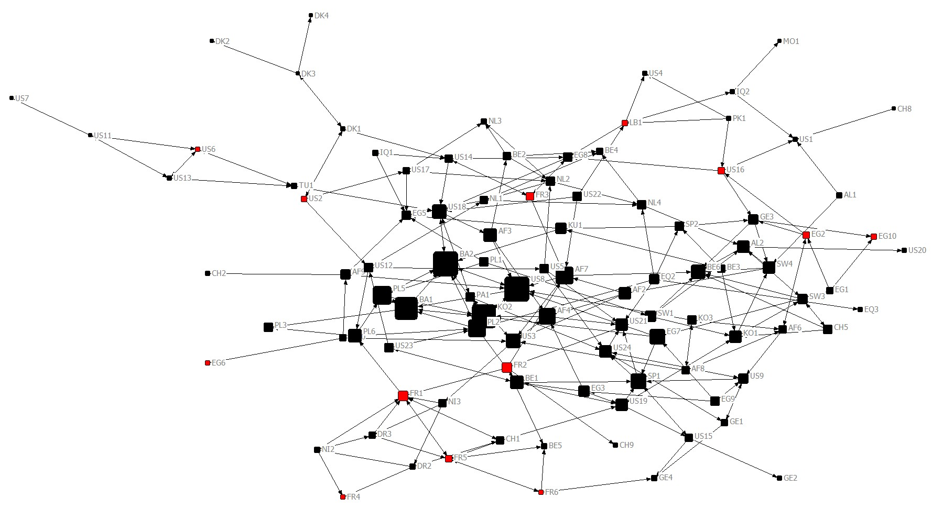
Impact of Previous Friendships
Most Friends Before conference
Size - Influence
As a result, those with the most friends has lower influence scores at the conference than one might expect

Slide 12
Impact of Previous Friendships
This indicates that people with larger social networks before the conference tended to stick with those social networks.
These individuals networks likely did not grow as much as those who had fewer prior friendships.
This could guide participant selection to try to focus on individuals with more nascent networks or potentially conference programing to force the intermingling of participants.

Slide 13
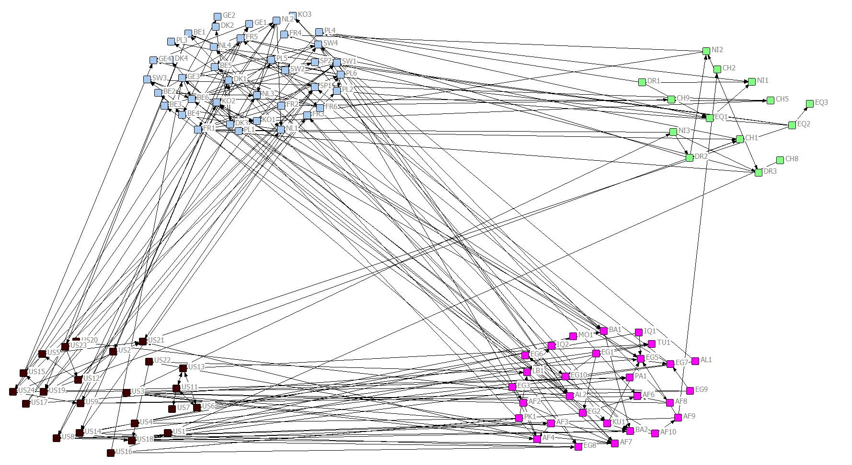
African Participants Less Connected
African participants were less likely to connect with American and Middle Eastern participants.
Europe
Africa
United States
MENA

Slide 14
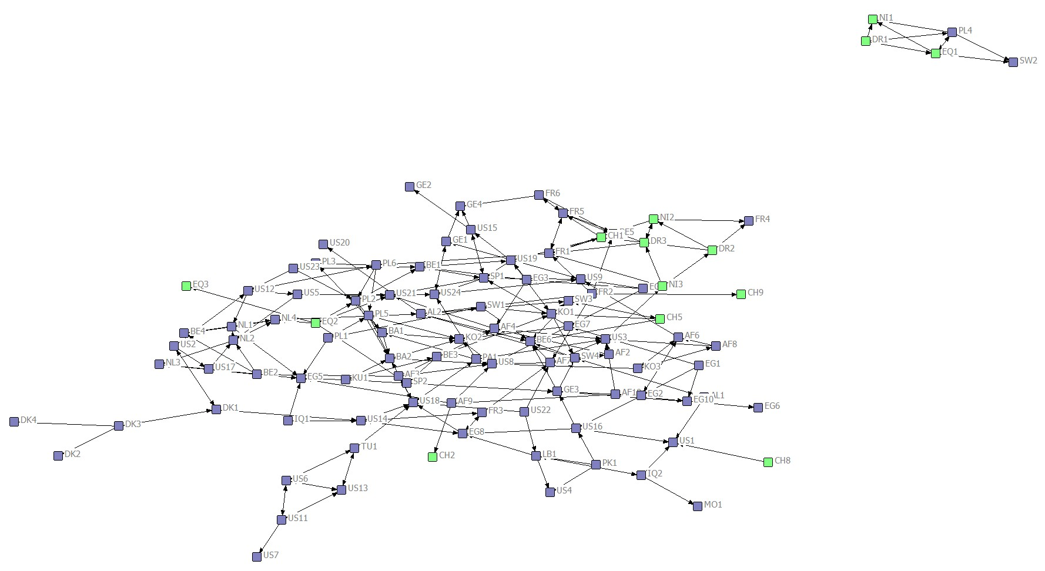
Regional Considerations
This results in African participants being marginalized to the periphery of the social network at the conference and the majority of the only
component not interconnected with
other participants.

Slide 15

Family Size Matters
The closer the number of siblings between the girls the more likely they were to spend time together
Image: http://www.nea.com

Slide 16
Main Findings
The conference introduced participants who likely would not have otherwise met though traditional networking.
Friends and Friends of Friends were likely to spend time together.
Less connected individuals were more likely to spend time with people they did not know before the conference.
Participants were likely to spend time with people with similar interests or backgrounds.
Participants from Africa had limited connections with those from the US and the Middle East. This caused them to be less central at the conference.

Slide 17
Recommendations
The results about African girls has enough spread that it should be studied farther but in Belgium staff should be cognizant to ensure girls from Africa are being integrated in groups
The conference setting offers an opportunity for social engineering that could generate even greater future results than random chance.
Friends will always seek each other out. However, these individuals can also benefit from being removed from these friends to force them to meet new people.
Create groups which intentionally put people in contact with people they might become friends with and others who are different to expose them to differences.

Slide 18
Limitations
Few African participants completed the pre and post survey so while they are significantly more likely to choose each other the confidence interval is extremely wide
Many missing factors which could be useful:
  What time did their flight arrive? How did they get from the airport to the hotel?
  With whom did they share a hotel room?
  What group were they in for ice breakers and team meetings?
  How were tables assigned for meals, with whom did they sit?
  How was transportation coordinated and groups assigned/selected?
Potential challenges with autocorrelation in statistical analysis.

